Slide 1
Introduction

Slide 2
Data

Slide 4


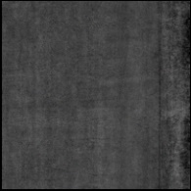
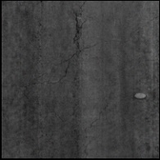
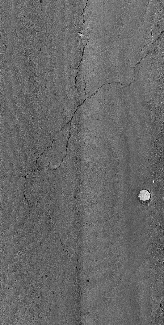
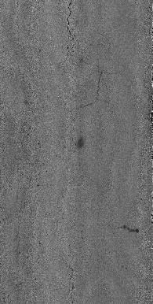

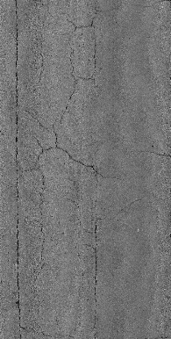
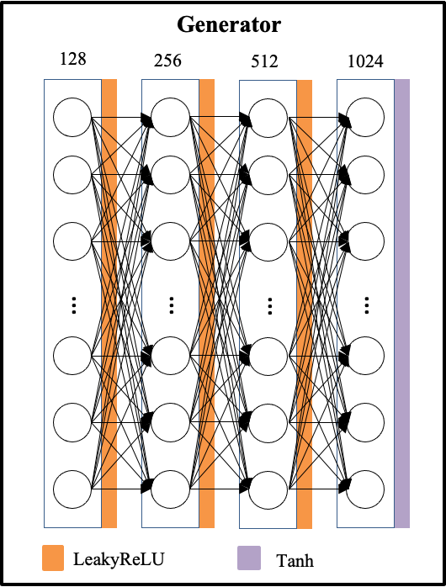
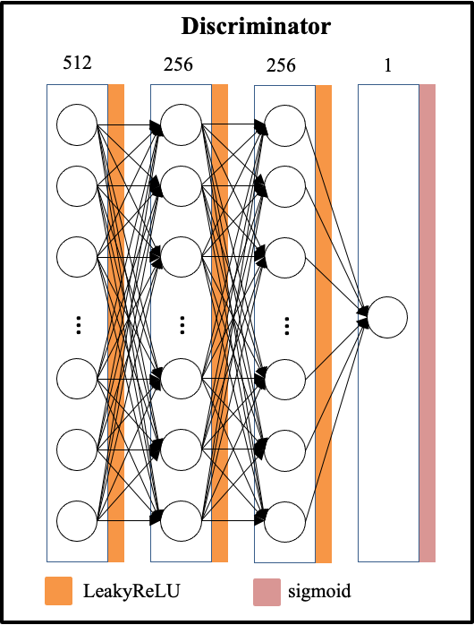
Generator
Discriminator
128
512
LeakyReLU
LeakyReLU
256
256
LeakyReLU
LeakyReLU
512
256
LeakyReLU
LeakyReLU
1024
1
Tanh
Sigmoid

Slide 5
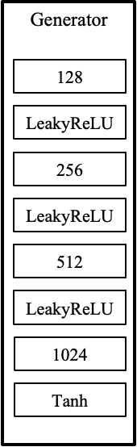
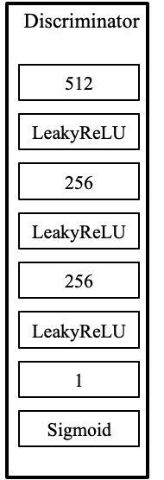
Random input vector
Update model
Fake images
Real/fake
Real images
Update model

Slide 6
Random input vector
Fake images
Update
model
Real images
Real/fake
Update model

Slide 7
Random input vector
Generator
Update model
Fake images
Discriminator
Real/fake
Real images
Update model

Slide 8
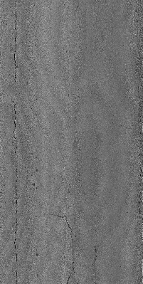
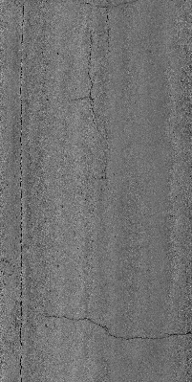
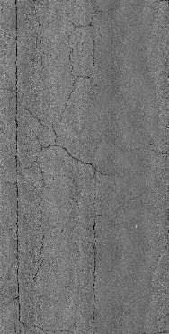
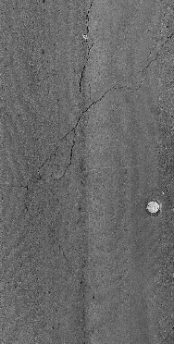
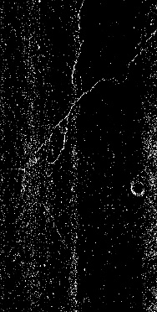
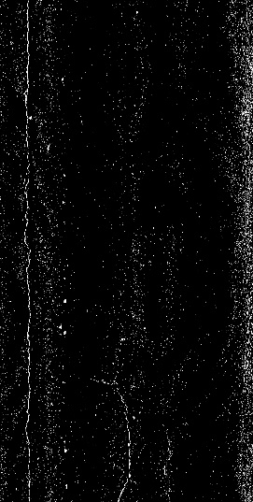
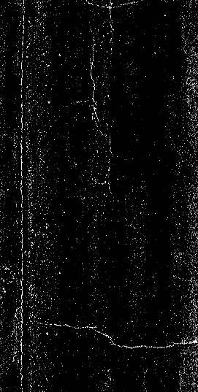
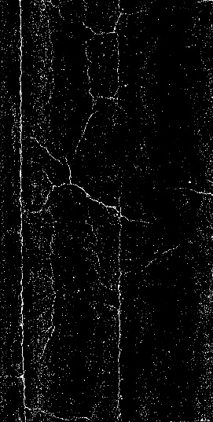
1
6
7
8

Slide 9
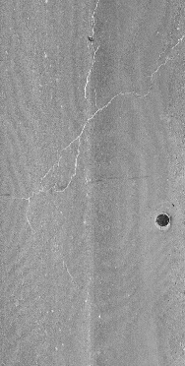
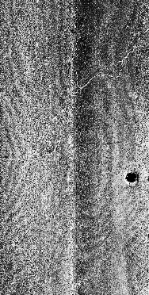
(a)
(b)
(c)
(d)

Slide 10
Pavement images
GAN
Annotation
Training
Validation
Yolov5
Testing

Slide 11
Pavement images
Training
Yolov5
Testing
GAN
Annotation
Validation

Slide 12
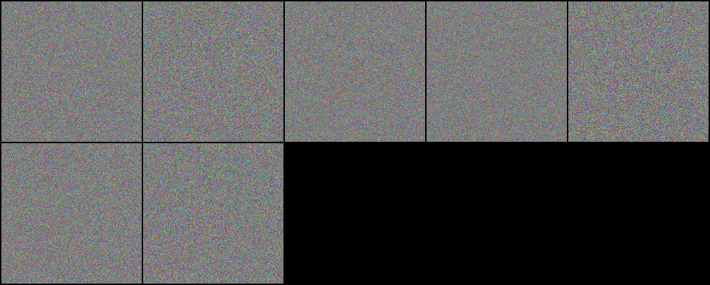
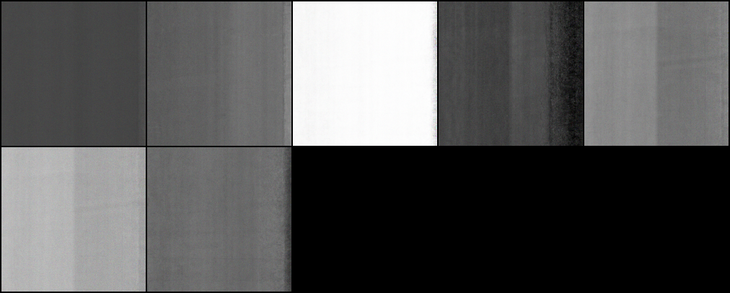
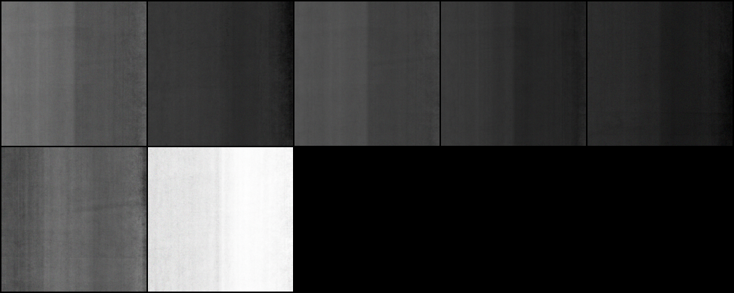
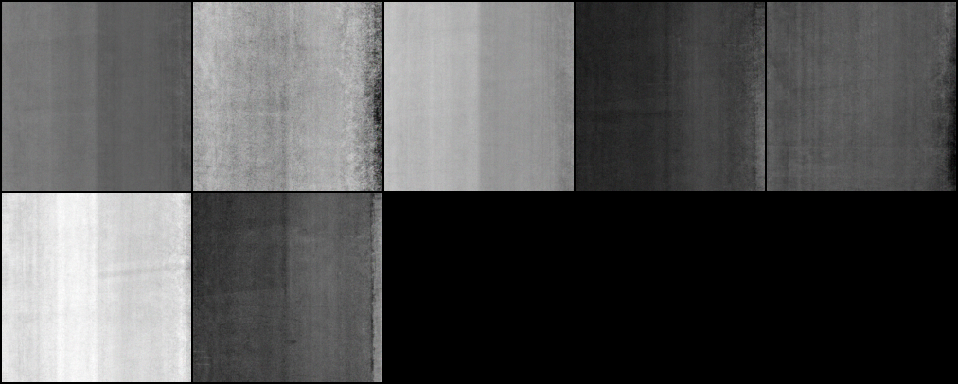
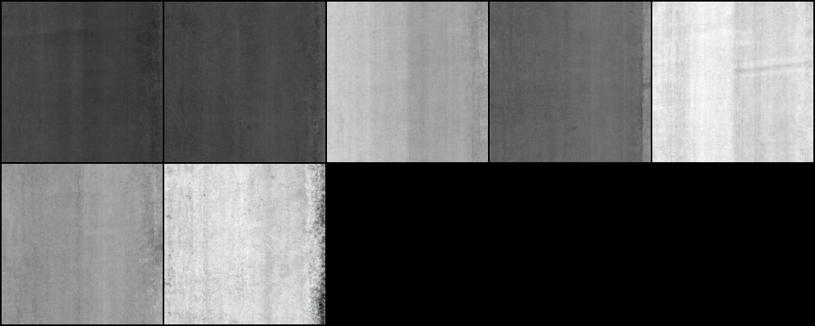
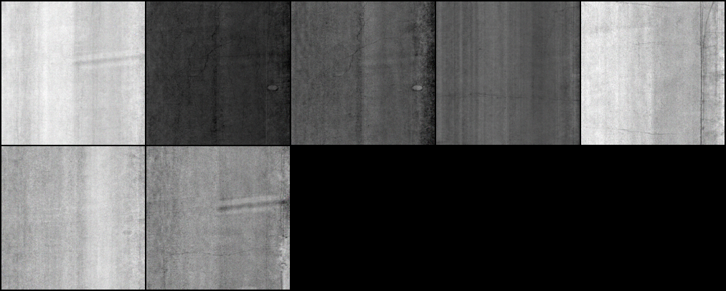
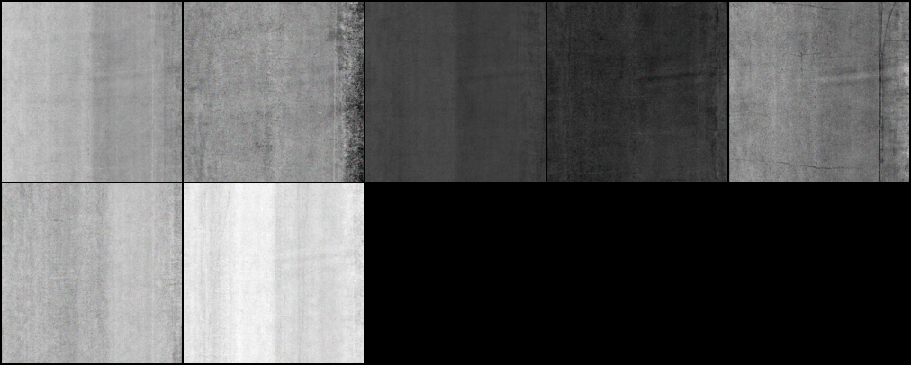
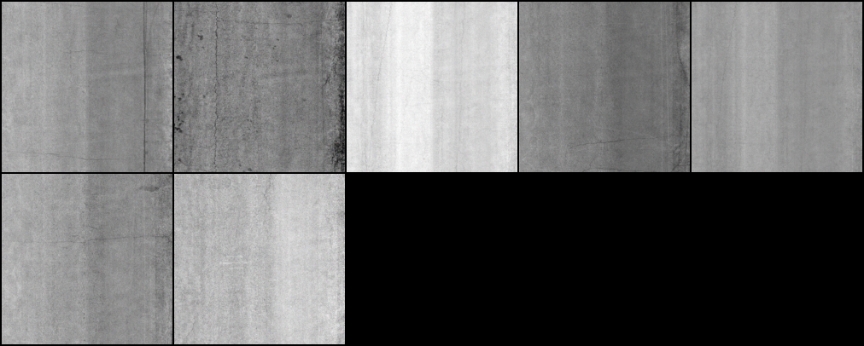
0
20000
40000
60000
80000
100000
120000
140000

Slide 13
Input Layer
LeakyReLU
Tanh
…
…
…
…
128
256
512
1024

Slide 14
Input Layer
Hidden Layer
…
…
…
…
128
256
512
1024

Slide 15
Generator
128
256
512
1024
…
…
…
…
LeakyReLU
Tanh

Slide 16
Discriminator
512
256
256
1
…
…
…
LeakyReLU
sigmoid

Slide 17
Generator
128
256
512
1024
…
…
…
…
LeakyReLU
Tanh

